Slide 1
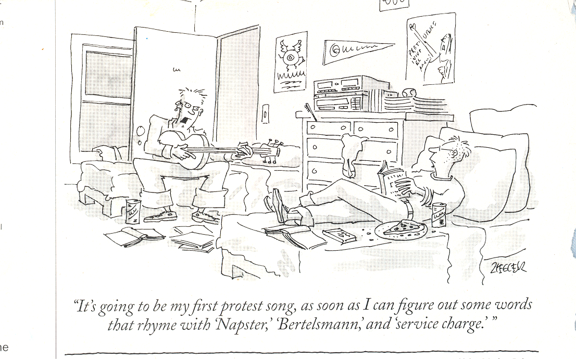
Multimedia
Dr. Shelly Heller
sheller@gwu.edu

Slide 2
Chapter 6: Multimedia Networking
Chapter Overview:
Multimedia Networking Apps
  compression
Streaming stored audio/video
  via web server
  via streaming server
  RTSP
Using best-effort service
  Recovering from jitter & loss
RTP
Better QoS
Scheduling & Policy Mechanisms
Integrated Services
RSVP
Differentiated Services

Slide 3
Properties of Multimedia
Video –
Huge Files
  35 frames per second for full motion
  200kbytes per frame
  35 frames in one second 7000 kbytes *8bits per byte
  56000 bits per second Minimum!
Impact of Compression
  Intra frame
  Inter frame

Slide 4
Properties of Multimedia
Video
Large files
  Capture analog sound
  Sample
    How often
    How deep
  Usually ~44000 samples per second at 16 bits
Compression
  Harder, based on human perception
  Need/purpose
quantization error
quantized value of
analog value
analog
signal
audio signal amplitude
time
sampling rate
(N sample/sec)
Multimedia Networking
9-<number>

Slide 5
Multimedia Service model
Uninterrupted
Fast approaching real time
Without error
Controllable
Applications provide
  Streaming
  Interactivity
  Continuous play

Slide 6
Application Classes (more)
Streaming
  Clients request audio/video files from servers and pipeline reception over the network and display
  Interactive: user can control operation (similar to VCR: pause, resume, fast forward, rewind, etc.)
  Delay: from client request until display start can be 1 to 10 seconds

Slide 7
Application Classes (more)
Unidirectional Real-Time:
  similar to existing TV and radio stations, but delivery on the network
  Non-interactive, just listen/view
Interactive Real-Time :
  Phone conversation or video conference
  More stringent delay requirement than Streaming and Unidirectional because of real-time nature
  Video: < 150 msec acceptable
  Audio: < 150 msec good, <400 msec acceptable

Slide 8
Challenges
TCP/UDP/IP suite provides best-effort, no guarantees on expectation or variance of packet delay
Streaming applications delay of 5 to 10 seconds is typical and has been acceptable, but performance deteriorate if links are congested (transoceanic)
Real-Time Interactive requirements on delay and its jitter have been satisfied by over-provisioning (providing plenty of bandwidth), what will happen when the load increases?...

Slide 9
Challenges (more)
Most router implementations use only First-Come-First-Serve (FCFS) packet processing and transmission scheduling
To mitigate impact of “best-effort” protocols, we can:
  Use UDP to avoid TCP and its slow-start phase…BUT we will see that’s its own problem
  Buffer content at client and control playback to remedy jitter
  Adapt compression level to available bandwidth

Slide 10
Solution Approaches in IP Networks
Just add more bandwidth and enhance caching capabilities (over-provisioning)!
Need major change of the protocols :
  Incorporate resource reservation (bandwidth, processing, buffering), and new scheduling policies
  Set up service level agreements with applications, monitor and enforce the agreements, charge accordingly
Need moderate changes (“Differentiated Services”):
  Use two traffic classes for all packets and differentiate service accordingly
  Charge based on class of packets
  Network capacity is provided to ensure first class packets incur no significant delay at routers

Slide 11
Sample ISP costs
How much internet speed do I need?
5+ MbpsRegular browsing
  Music streaming
  Ideal for 1 person
10+ MbpsHD video streaming
  Casual gaming
  Ideal for 1-2 people
20+ MbpsUltra HD streaming ~$50/month
  Frequent gaming
  Ideal for 2-4 people
40+ MbpsSimultaneous HD streaming
  Simultaneous gaming
  Ideal for 4+
100 Mbps $39/month (Verizon)
Notes:
Fios Internet - No annual contract
Limited-time online offer for new Fios Internet residential customers subscribing to a Fios Internet plan. Promo rates via bill credits and increase after promo period. $12/mo. router charge and ther fees, taxes, equip. charges & terms may apply. Auto Pay (ACH or bank debit card only) & paper-free billing req’d. Subj. to credit approval & may require a deposit.
* Offer for new Fios Internet res. customers is non-transferable and has no cash or refund value. Documentation of early termination fee (ETF) for TV, Internet and phone from your prior service provider must be provided w/in 90 days of installation and offer will be fulfilled via bill credit, to your Verizon account, in the amount of the ETF up to $500. You remain solely responsible for paying the ETF to your prior service provider. If you cancel your Verizon service w/in 90 days of installation, the ETF credit will be charged back to your final bill.

Slide 12
Streaming
streaming, stored audio, video
  streaming: can begin playout before downloading entire file
  stored (at server): can transmit faster than audio/video will be rendered (implies storing/buffering at client) Usually CDN
  e.g., YouTube, Netflix, Hulu
conversational voice/video over IP
interactive nature of human-to-human conversation limits delay tolerance
  e.g., Skype
streaming live audio, video (ie sports)
Notes:
Impact of delay distrupting

Slide 13



Streaming
Server out buffer
Client Buffer, partially filled
Server
Client
Notes:
Start streaming from server
Fill client buffer a bit before showing video
Once you have enough, start showing – to avoid showing and running out of video.
You want to the throughoput to be > or = to media rate –
Buffer absorbs possible delays
BUT what happens IF client side pauses the play of video? The streaming still sends stuff UNTIL buffer full? All halts
Hi

Slide 14
Using HTTP as a delivery of Video
Why Not UDP?
  UDP sends at a available rate,
  no data checking
Application layer – heavy work on client side buffer
  HTTP streaming
    Get the file
    Buffer it
    No control channel
  Adaptive HTTP streaming
Notes:
Without data checking need header with identifications and need a control line
UDP problems – UDP might not send at constant rate, hence play might not be continuous
Will need a media control chanle for pause, etc
Firewalls don’t like USP

Slide 15
Limits of UDP
VoIP could use UDP
Best effort
  UDP encapsulates data into packet
  Packet could get lost (at queues, etc)
  Use TCP – but that has retransmission
    Doesn’t work for real time
    Up to 20% can be tolerated and loss can be concealed
    FEC – Forward Error Correction
      For every n chunks, send a exclusive OR of packets
      Use small n
      Send a second lower rate stream
Notes:
Exclusive or – can correct one lost packet – not more

Slide 16
Delay and Jitter
Humans can manage delays
  Not more than 400 milliseconds
Jitter – caused by delay
  If we play as items arrive
  Uneven arrival rate will cause jitter
What to do?
  Hold for play – forced delay in playing
  Use FEC
  Interleaving

Slide 17
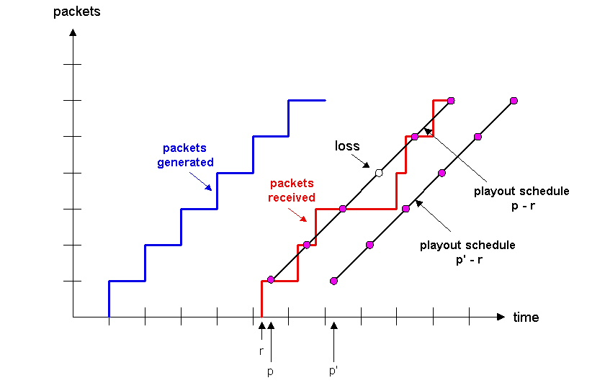
Internet Phone with Fixed Playout Delay

Slide 18
HTTP and Multimedia
Pre-fetching
  Usually want streaming at least to the video transmission rate – but it the bandwidth is greater, use it – fetch more
  Allows buffers to build up
Pause, jump, etc
  HTTP uses a header with the range of bytes
  Request a specific start
  Could waste the stuff already in the buffer

Slide 19
Recovery From Packet Loss
Mixed quality streams are used to include redundant duplicates of chunks; upon loss playout available redundant chunk, albeit a lower quality one
With one redundant chunk per chunk can recover from single losses

Slide 20
Recovery From Packet Loss
Loss is in a broader sense: packet never arrives or arrives later than its scheduled playout time
Since retransmission is inappropriate for Real Time applications, FEC (Forward Error Correction) or interleaving are used to reduce loss impact.
Simplest FEC scheme adds a redundant chunk made up of exclusive OR of a group of n chunks; can reconstruct if at most one lost chunk; The more chunks (ie reduce the size of n) the more lost data can be recovered at a cost of many duplications, playout time schedule assumes a loss per group

Slide 21
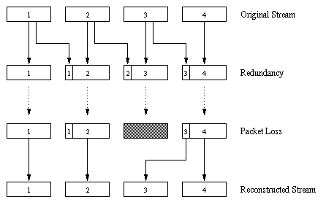
Piggybacking Lower Quality Stream

Slide 22
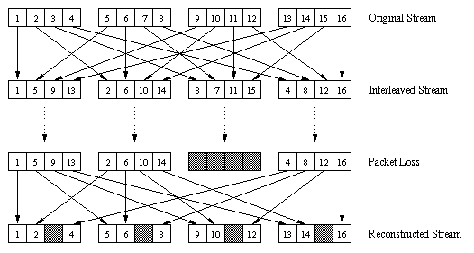
Interleaving
Alternative for lost data
Has no redundancy, but can cause delay in playout beyond Real Time requirements
Divide 20 msec of audio data into smaller units of 5 msec each and interleave
Upon loss, have a set of partially filled chunks

Slide 23
Streaming
Streaming multimedia applications need hard real-time guarantees (do not tolerate losses or (excessive) delay jitter
Software solutions
  should support mulicast
  cannot wait for lost packets/segments/datagrams to be retransmitted
  need to associate some timing information (timestamps) with packets/segments/datagrams
  What about TCP ? What about UDP ?
Important and growing application due to reduction of storage costs, increase in high speed net access from homes,enhancements to caching and introduction of QoS in IP networks
Audio/Video file is segmented and sent over either TCP or UDP, public segmentation protocol: Real-Time Protocol (RTP)

Slide 24
RTP
Real-time Interactive Applications use RTP
Headers for Multimedia data (PCM (voice) MP3, Mpeg etc) have sequence numbers and time stamps and are used by RTP
Usually runs on top of UDP
  Sender encapsulates media into RTP packet, then to UDP, then to IP (and reverse at receiver)
No guarantees (except interoperability)
Think of it as the transfer of data standard

Slide 25

Real-Time Protocol (RTP)
Provides standard packet format for real-time application
Typically runs over UDP
Specifies header fields below
Payload Type: 7 bits, providing 128 possible different types of encoding; eg PCM, MPEG2 video, etc.
Sequence Number: 16 bits; used to detect packet loss

Slide 26
Streaming
User interactive control (playback, etc)is provided, e.g. the public protocol Real Time Streaming Protocol (RTSP) (Once the data arrives aided by RTP)
RTSP does not define compression, sending is done via RTP, does not control buffer etc
Helper Application: displays content, which is typically requested via a Web browser; e.g. RealPlayer; GUI for user control

Slide 27
Real-Time Protocol (RTP)
Timestamp: 32 bytes; gives the sampling instant of the first audio/video byte in the packet; used to remove jitter introduced by the network
Synchronization Source identifier (SSRC): 32 bits; an ID for the source of a stream; assigned randomly by the source

Slide 28
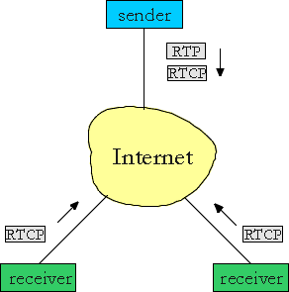
RTP Control Protocol (RTCP)
Protocol specifies report packets exchanged between sources and destinations of multimedia information
Three reports are defined: Receiver reception, Sender, and Source description
Reports contain statistics such as the number of packets sent, number of packets
lost, inter-arrival jitter
Used to modify sender
transmission rates and
for diagnostics purposes

Slide 29
What are the buzzwords
RTSP - Client-server multimedia presentation control protocol - control protocol for initiating and directing delivery of streaming multimedia from media servers (Does not deliver data)
RTP is a transport protocol for the delivery of real-time data, including streaming audio and video. It is a packet format for multimedia data streams.
RTCP is a part of RTP and helps with lip synchronization and QOS management, among others

Slide 30
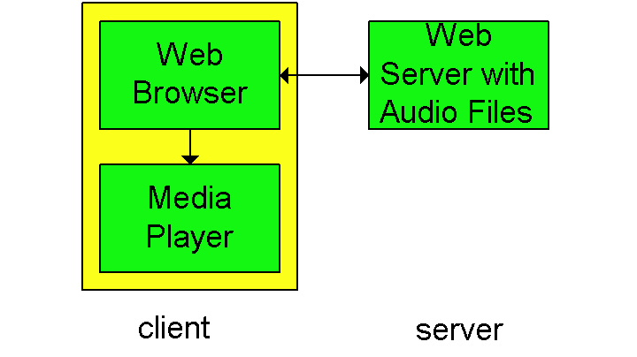
Streaming From Web Servers
Audio: in files sent as HTTP objects
Video (interleaved audio and images in one file, or two separate files and client synchronizes the display) sent as HTTP object(s)
A simple architecture is to have the Browser requests the object(s)
and after their
reception pass
them to the player
for display
  - No pipelining

Slide 31
Streaming From Web Server (more)
Alternative: set up connection between server and player, then download
Web browser requests and receives a Meta File
(a file describing the object) instead of receiving the file itself;
Browser launches the appropriate Player and passes it the Meta File;
Player sets up a TCP connection with Web Server and downloads the file

Slide 32
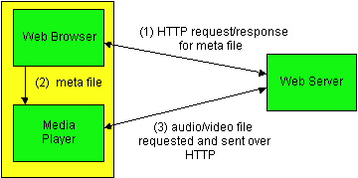
Meta file requests

Slide 33
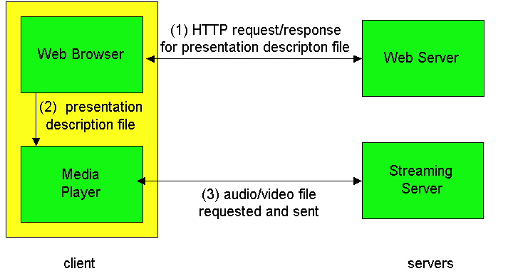
Using a Streaming Server
This gets us around HTTP, allows a choice of UDP vs. TCP and the application layer protocol can be better tailored to Streaming; many enhancements options are possible (see next slide)

Slide 34
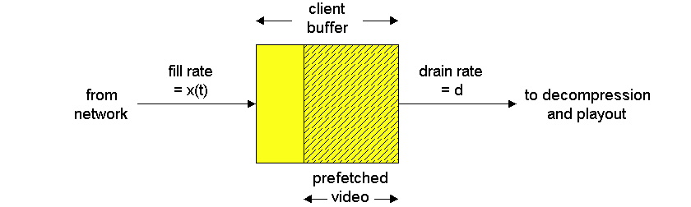
Options When Using a Streaming Server
Use UDP, and Server sends at a rate (Compression and Transmission) appropriate for client; to reduce jitter, Player buffers initially for 2-5 seconds, then starts display
Use TCP, and sender sends at maximum possible rate under TCP; retransmit when error is encountered; Player uses a much large buffer to smooth delivery rate of TCP

Slide 35
What should the future look like?
What would
  A network Admin say?
  A Media Provider say?
  A User say?

